Slide 1
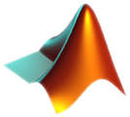
2D FOURIER TRANSFORMS AND IMAGE FILTERS
DAVID COOPER
SUMMER 2014

Slide 2
Extending into Multidimensional space
Both Fourier Transforms and Correlations can be extended into 2D and are useful for Image processing
2D Fourier transforms can be used with multiple types of microscopy techniques for extracting information on patterns displayed
Correlations are typically used to apply filters over an image highlighting certain aspects of the affected image

Slide 3
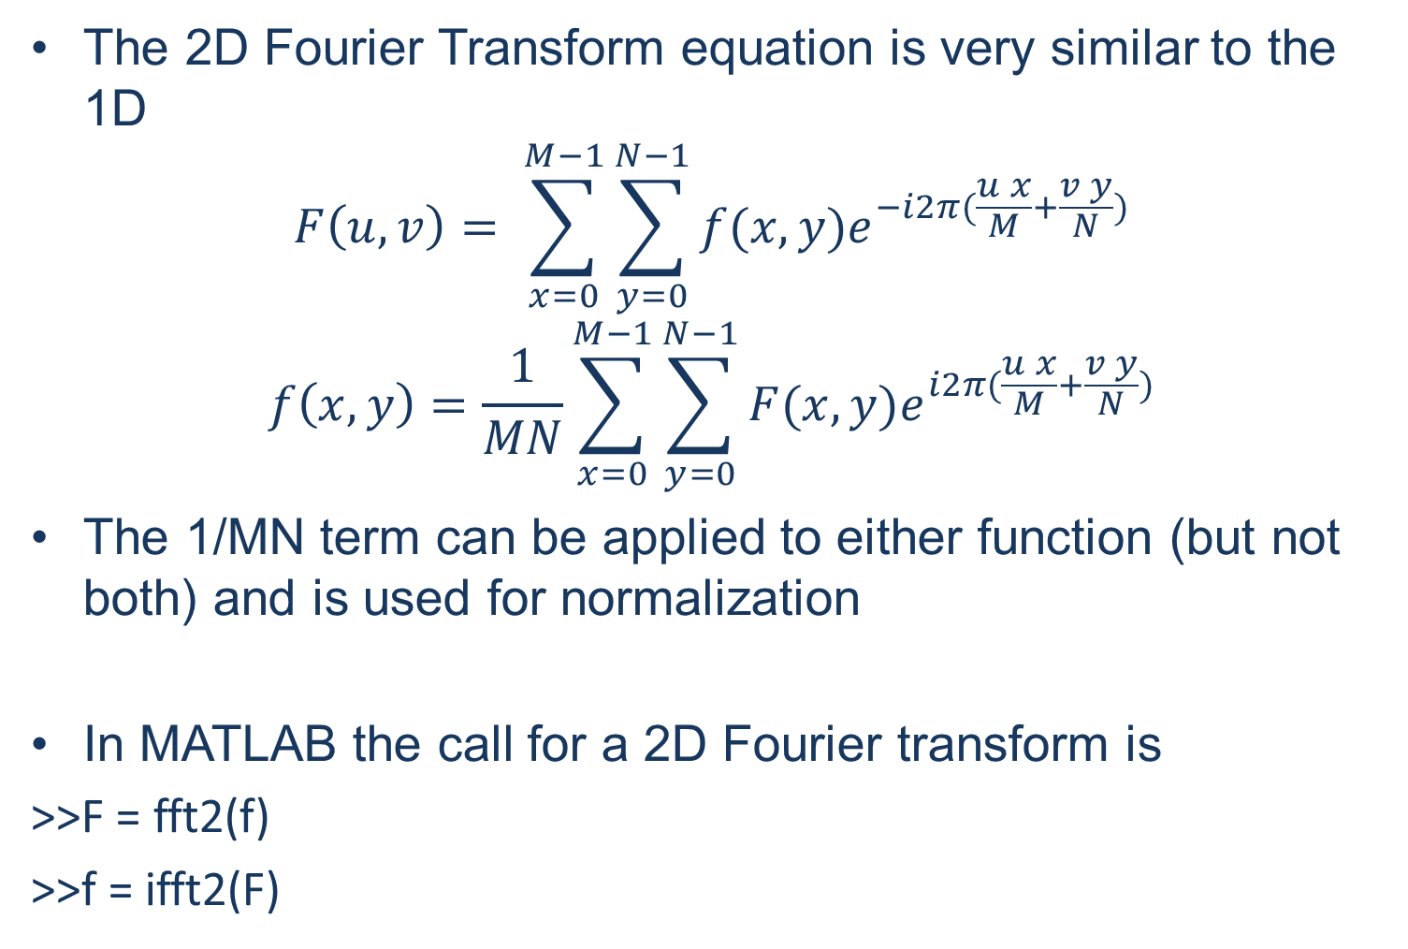
2D Fourier Transform

Slide 4
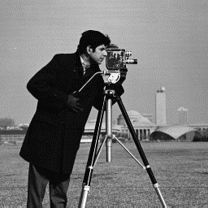
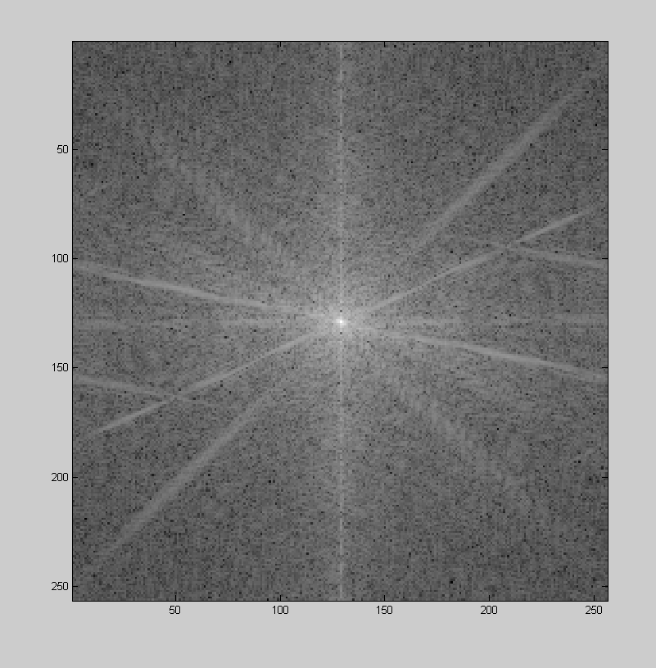
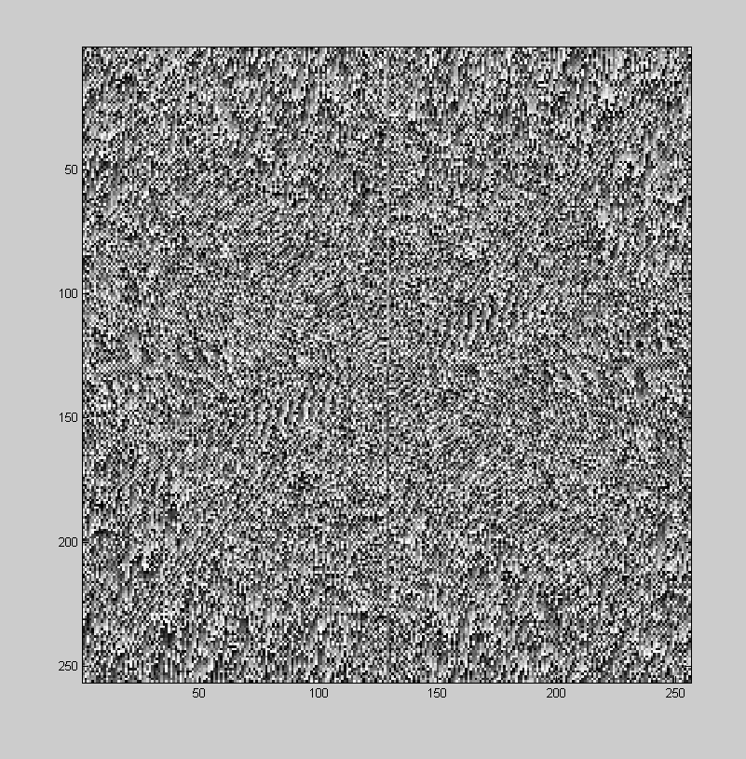
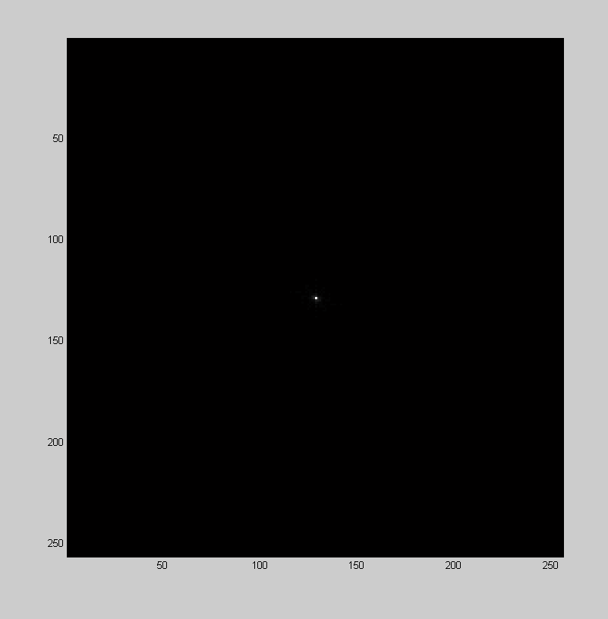
Magnitude and Phase
Just like 1D we can separate the magnitude and the phase
>>Fmag = abs(F)
>>Fphase = angle(F)
Magnitude
Phase

Slide 5
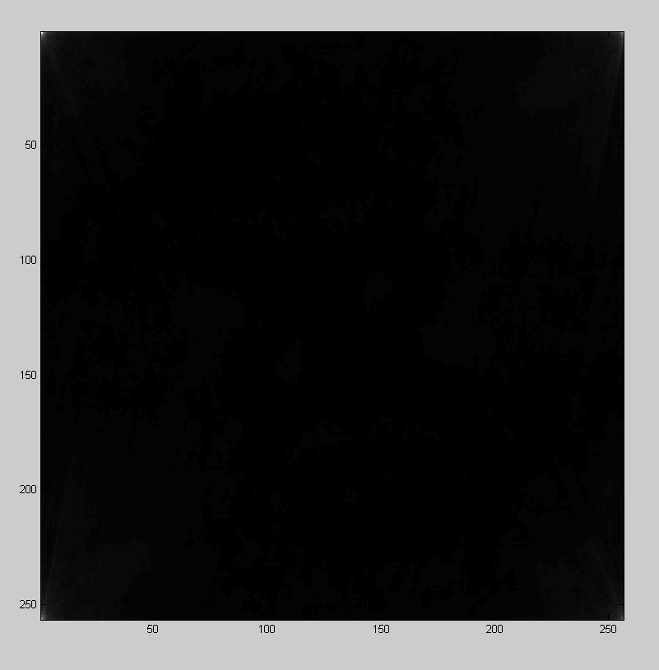
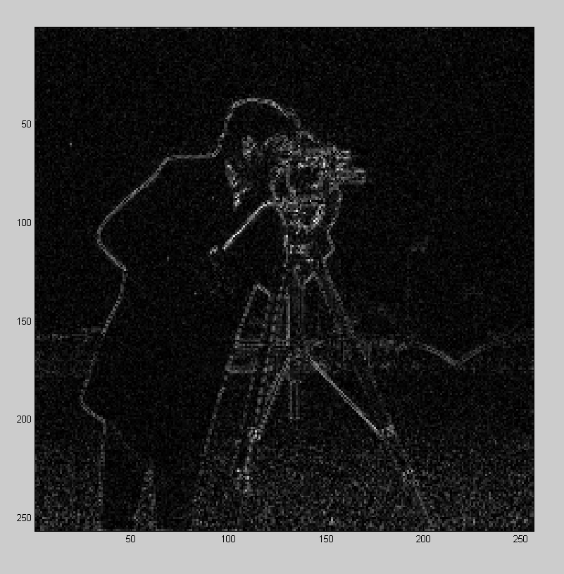
Importance of Magnitude and Phase
If we reconstruct the image from just the magnitude and just the phase we can see where the important information lies
Magnitude
Phase

Slide 6
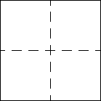
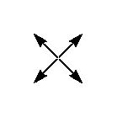
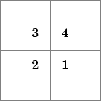
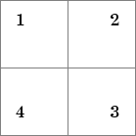
Useful functions for plotting FT
There are several useful functions for plotting Fourier Transforms
fftshift() is used to rearrange the frequency space images so that they are easier to read and interpret
>>Fshifted = fftshift(F)
For plotting images use either imshow() or imagesc()
>> imshow(Fmag)
>> imagesc(Fphase)

Slide 7
Correlation in 2D
Correlations and convolutions are performed by summing the product of all of the overlapping elements over the entire image
While any two matrices can be correlated with each other, typically you are applying a small filter over a singular image
The filter that you apply comes in the form of a smaller matrix of weighted values called a kernel
To perform a convolution instead of a correlation rotate the secondary matrix by 180 degrees

Slide 8
Implementing Filters
The main function in MATLAB to perform image filtering is imfilter()
>> B = imfilter(A,k)
imfilter() has three main options; size, type, and boundary conditions
The default size is ‘same’ which returns an image the same size as A. Specifying ‘full’ will return a larger image that is 2(size(k) – 1)+size(A)
>> Afull = imfilter(A,k,’full’)
You can also specify correlation or convolution with ‘corr’ or ‘conv’

Slide 9
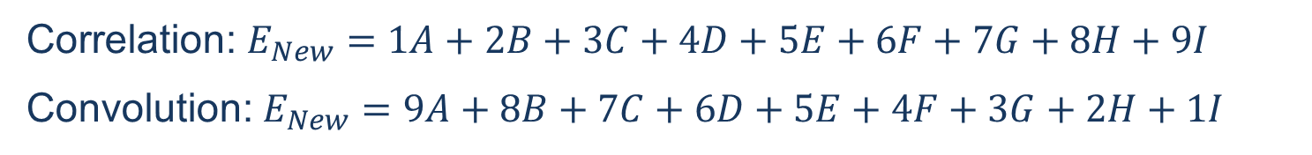
Applying the Kernel
1 | 2 | 3
4 | 5 | 6
7 | 8 | 9
Image Kernel
A | B | C
D | E | F
G | H | I
1 | 2 | 3
4 | 5 | 6
7 | 8 | 9

Slide 10
Border Effects
The border of the image presents a unique situation for filtering
There are 4 main ways of dealing with the boundary values; input a value (‘X’), symmetrically reflect the image (‘symmetric’), replicate the last value (‘replicate’), and circularize by repeating the full image (‘circular’)
The default is to assume all values are 0 outside of the image
However ‘replicate’ is often the best option to prevent edge distortions

Slide 11
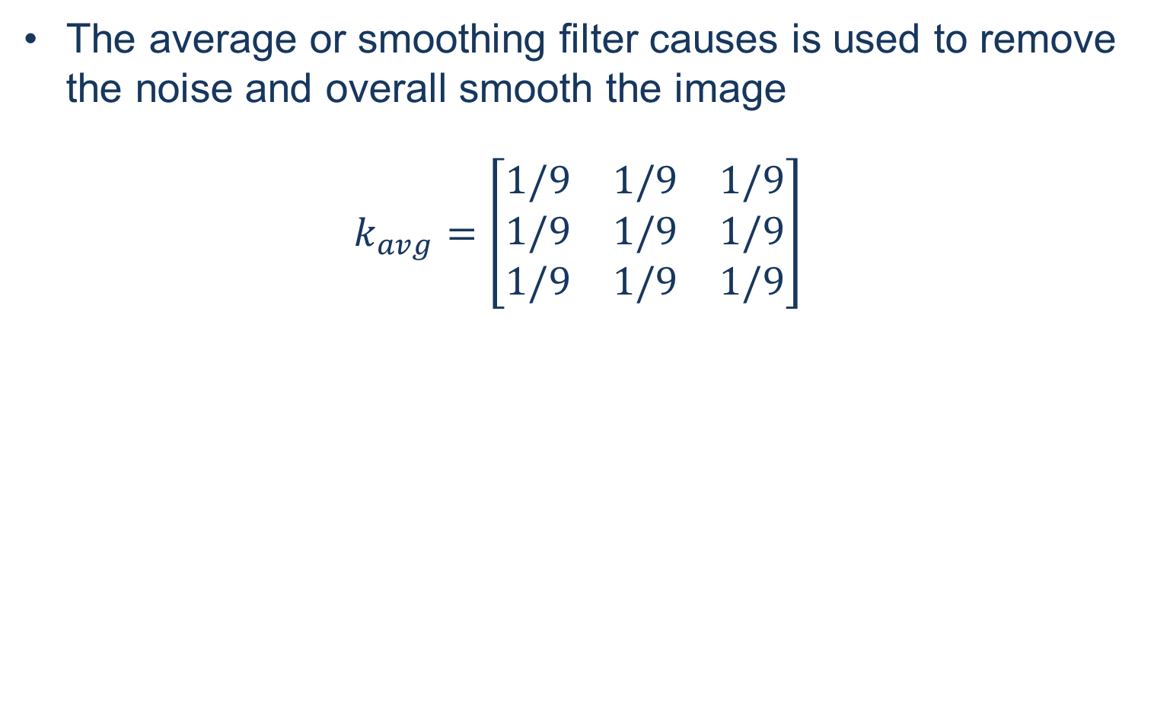
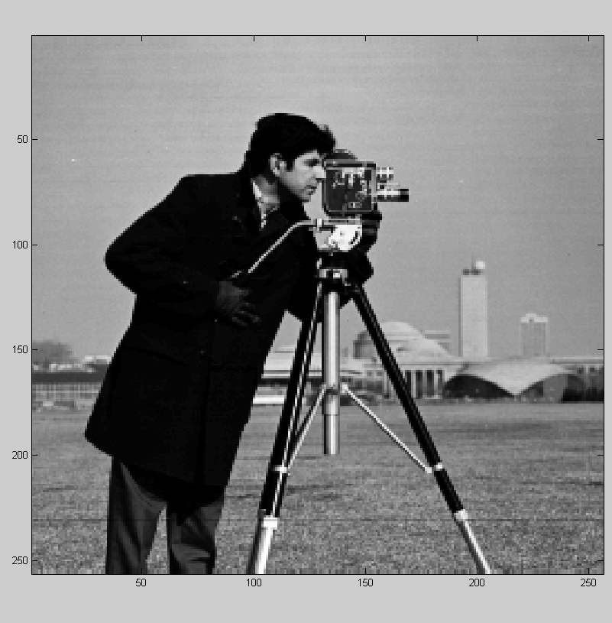
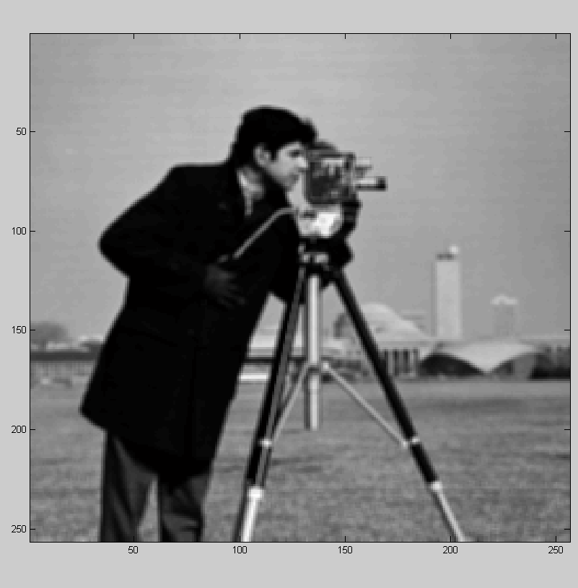
Common Filters: Averaging

Slide 12
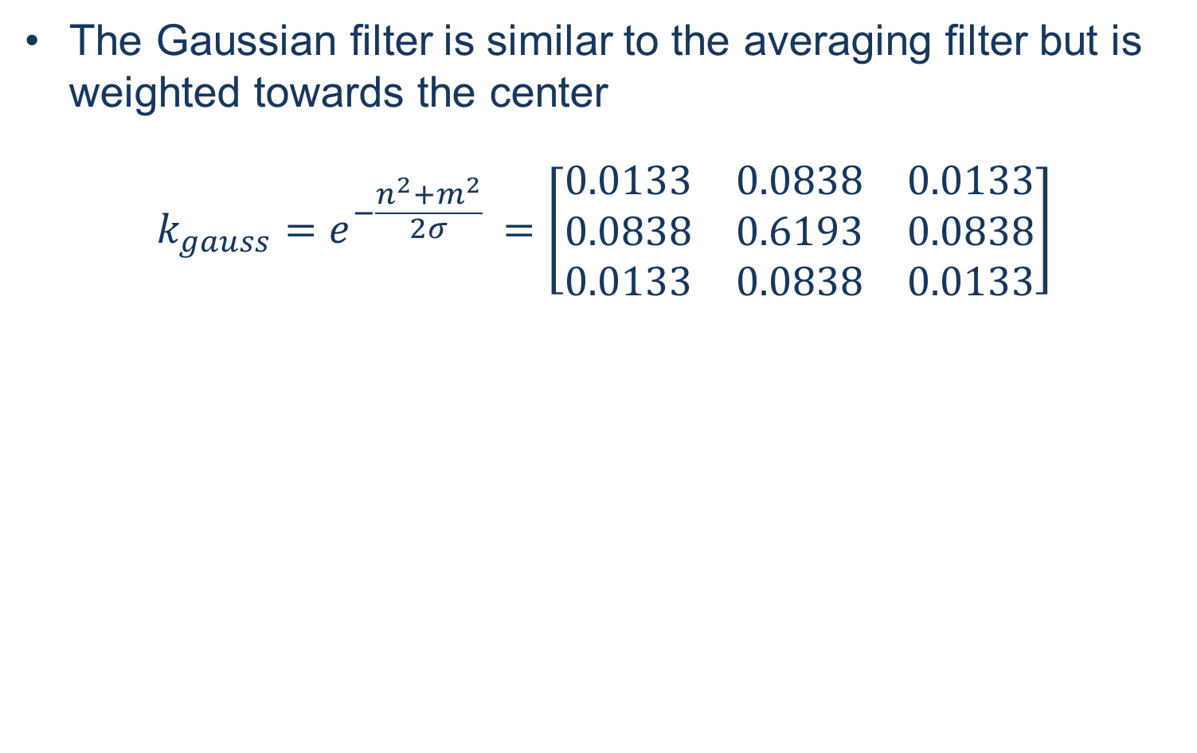

Common Filters: Gaussian

Slide 13
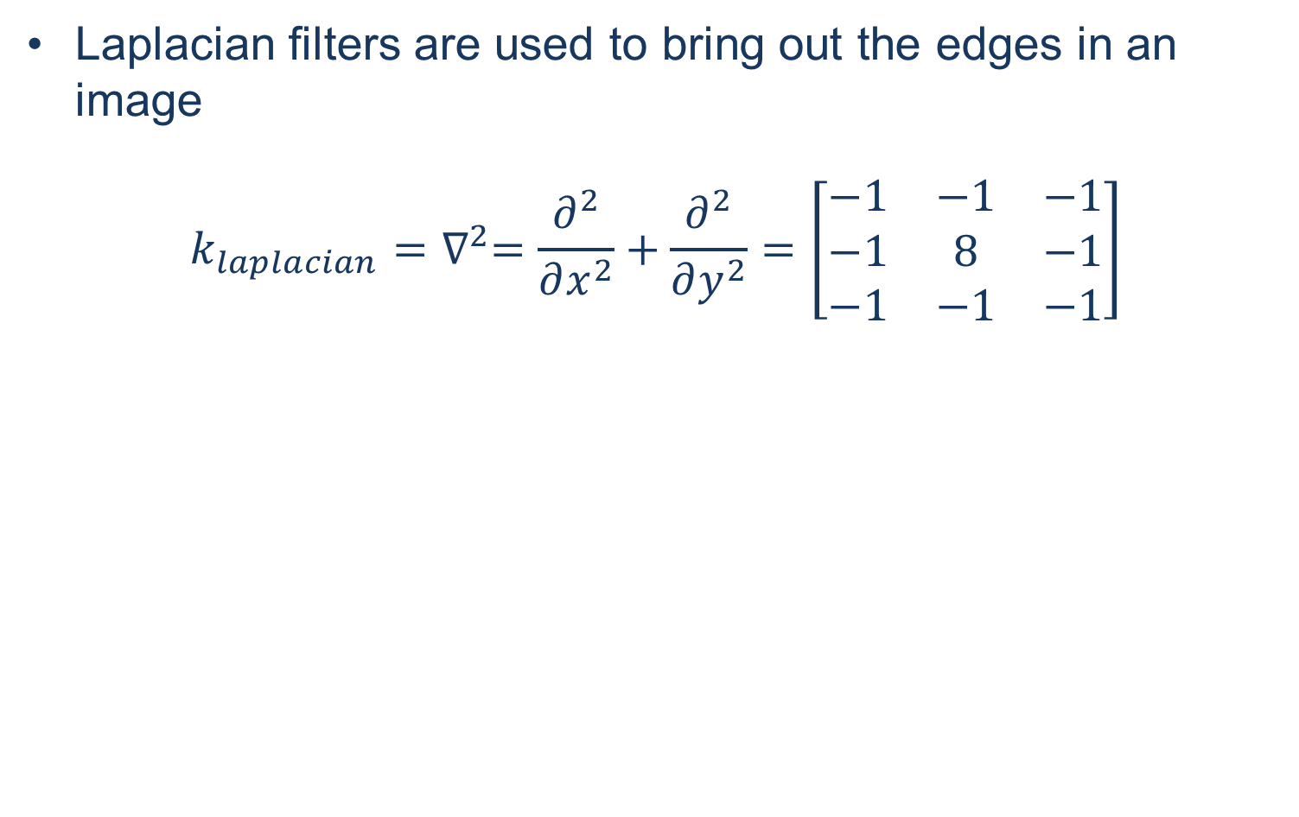
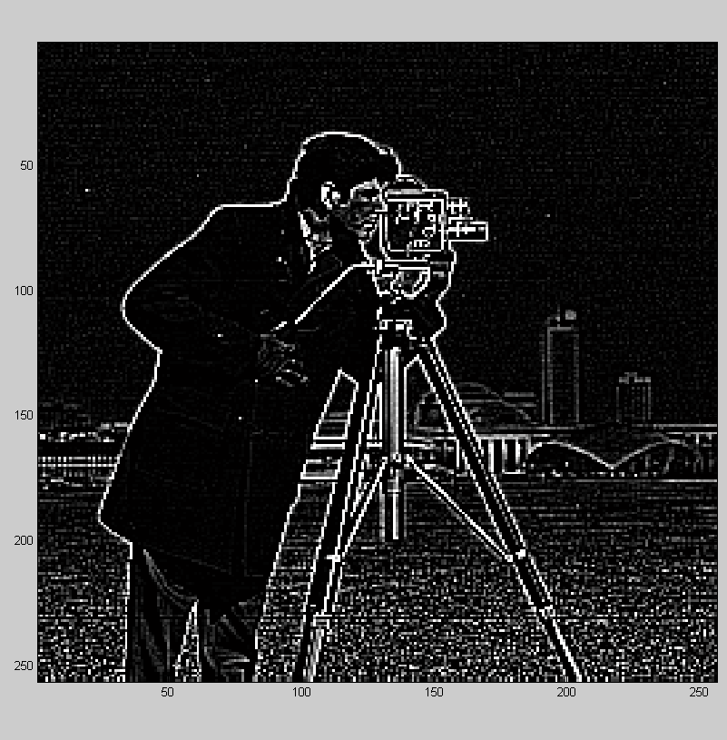
Common Filters: Laplacian

Slide 14
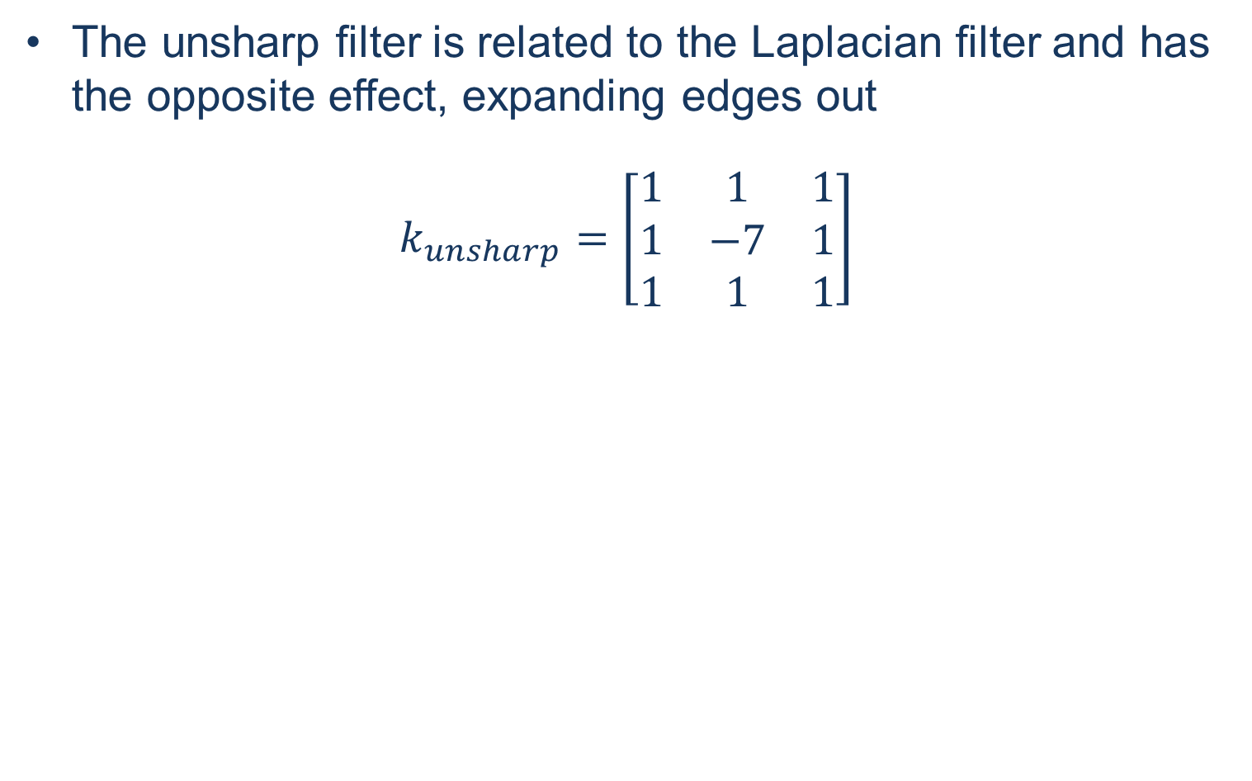
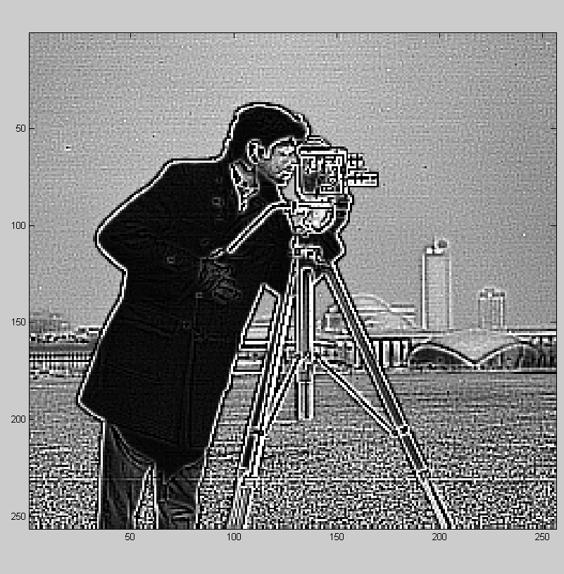
Common Filters: Unsharp

Slide 15
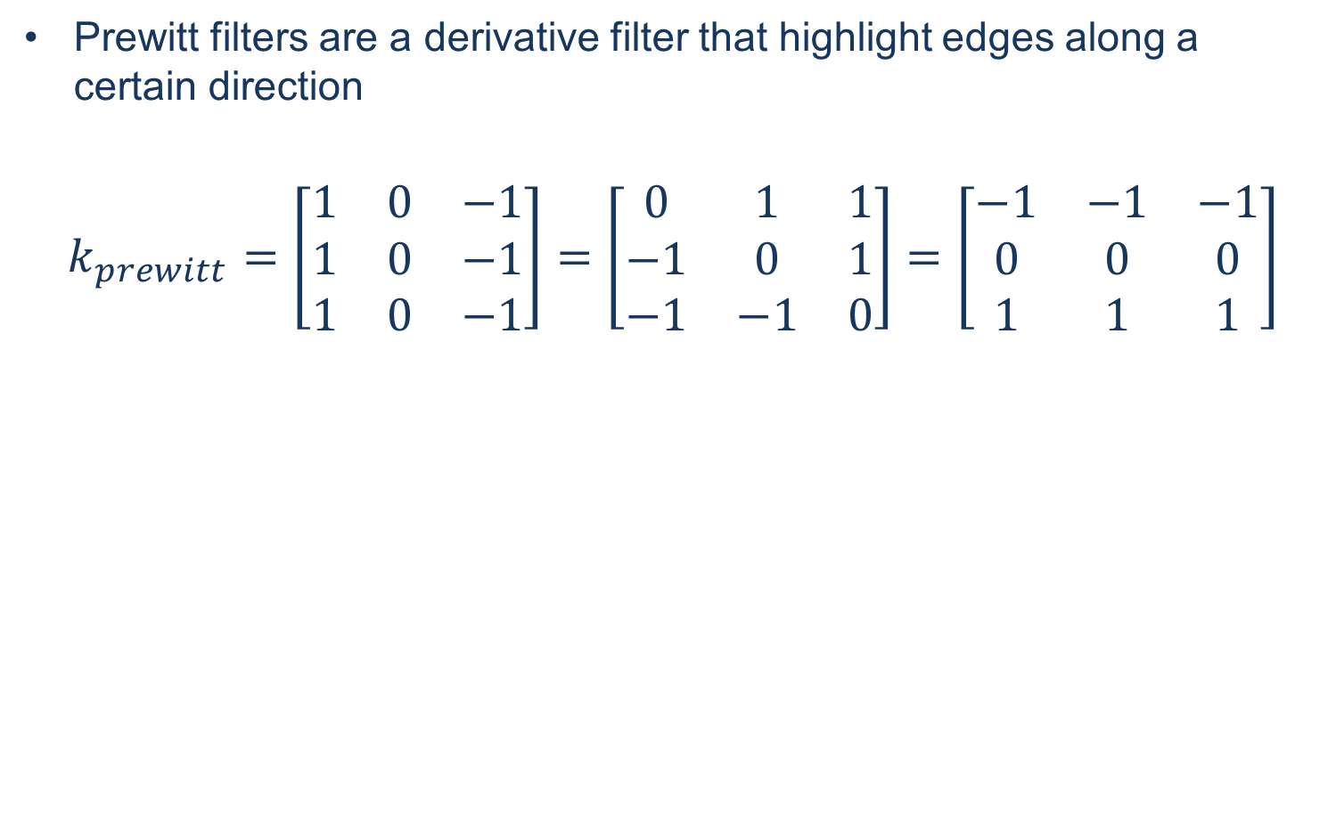
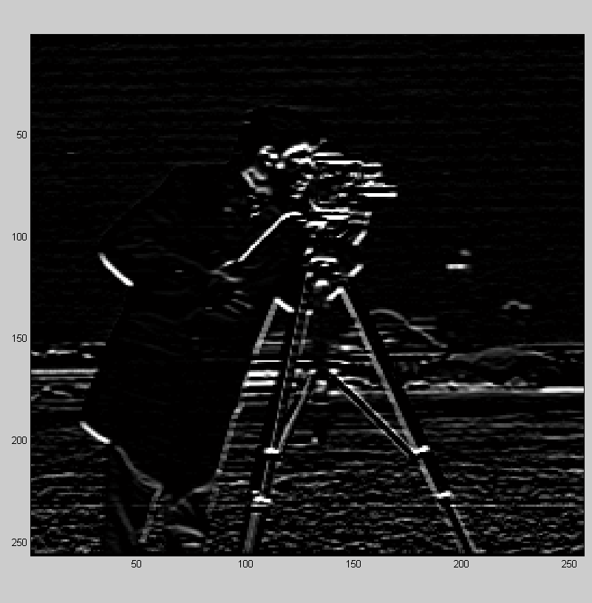
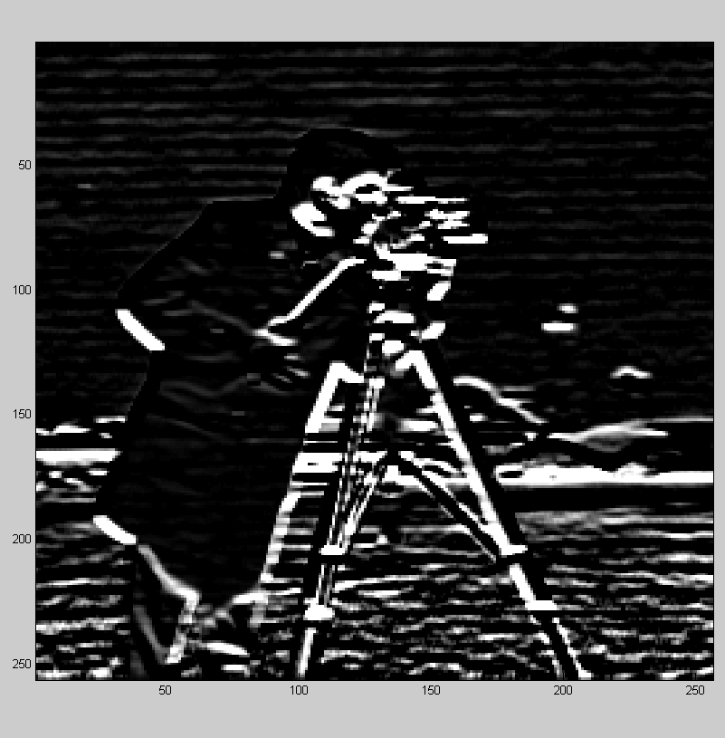
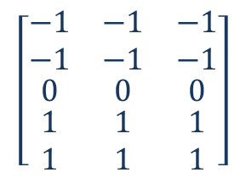
Common Filters: Prewitt
Note: increasing the size of the filter increases the thickness of the edges

Slide 16
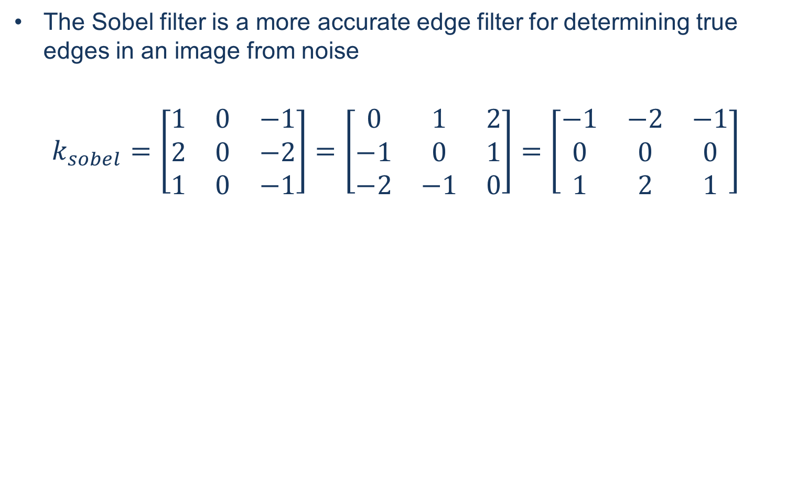
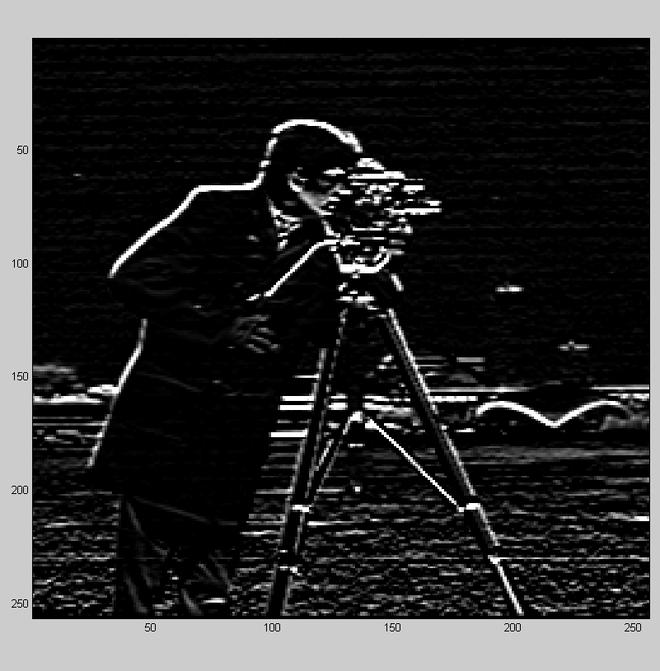
Common Filters: Sobel

Slide 17
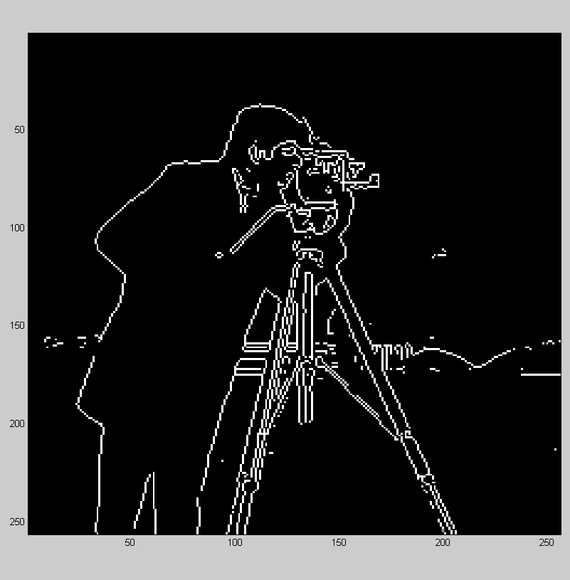
Edge finding
MATLAB includes a function designed to find all of the edges in a given image returning a binary with all of the identified edges
>> B = edge(A)
edge() also lets you select the method of finding the edge, including the prewitt and sobel methods, as well as the threshold for determining the true edges from noise

Slide 18
Generating Predefined Kernels
While it is possible to create all of the filters by hand MATLAB includes a number of them prebuilt
>> k = fspecial(‘filterType’)
The possible filters
are listed here
The default size for
most of them is [3 3]
You can also add
distribution parameters
for many of the filters
Value | Description
average | Averaging filter
disk | Circular averaging filter (pillbox)
gaussian | Gaussian lowpass filter
laplacian | Approximates the two-dimensional Laplacian operator
log | Laplacian of Gaussian filter
motion | Approximates the linear motion of a camera
prewitt | Prewitt horizontal edge-emphasizing filter
sobel | Sobel horizontal edge-emphasizing filter

